Slide 1


Slide 2
Introduction
What is software?
What is Software Engineering?

Slide 3


What is software?
  Computer programs and associated documentation
Software products may be developed for a particular customer or may be developed for a general market
Software products may be
  Generic - developed to be sold to a range of different customers
  Bespoke (custom) - developed for a single customer according to their specification

Slide 4
Definition of Software
Software consists of computer programs, procedures, rules, relevant documentation and data pertaining to the operation of the software.
IEEE defines software as the collection of
computer programs, procedures, rules
and associated documentation and data.

Slide 5
Software problem
Software is expensive
Late costly and unreliable
Problem of change and rework

Slide 6
What are the attributes of good software?
The software should deliver the required functionality and performance to the user and should be maintainable, dependable and usable.
Maintainability
  Software must evolve to meet changing needs
Dependability
  Software must be trustworthy
Efficiency
  Software should not make wasteful use of system resources
Usability
  Software must be usable by the users for which it was designed

Slide 7
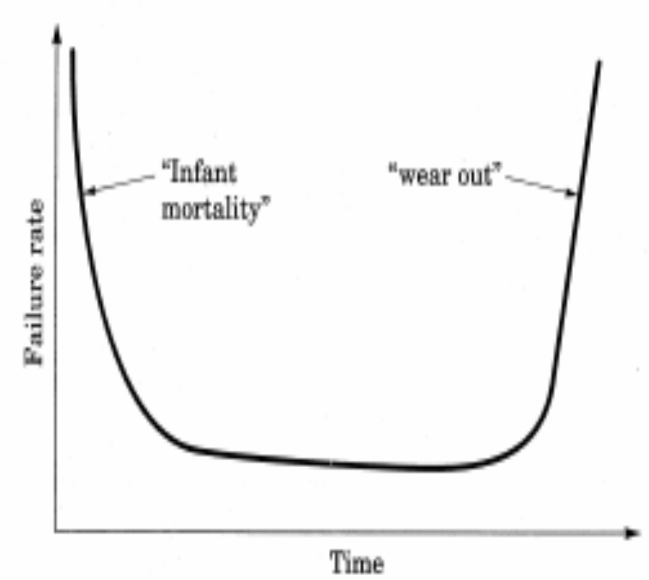
Some Software Characteristics
Engineered or developed, not manufactured in the traditional sense.
Software does not
wear out in the same
sense as hardware.

Slide 8
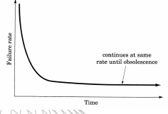
Some Software Characteristics
In theory, software does not wear out at all.
BUT,
Hardware upgrades.
Software upgrades.

Slide 9
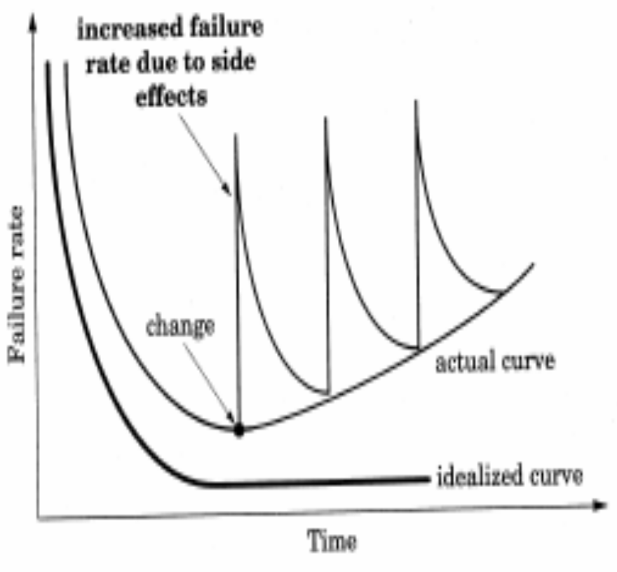
Some Software Characteristics
Reality is more like
this.
Most serious corporations
control and constrain
changes.
Most software is
custom built, and
customer never really
knows what she/he
Wants
Right: actual failure
rate for software

Slide 10
Engineering
The science concerned with putting scientific knowledge to practical use.
  Webster’s Dictionary
Physics versus Electrical Engineering

Slide 11
What is software engineering?
Software engineering is an engineering discipline which is concerned with all aspects of software production
Software engineers should
  adopt a systematic and organised approach to their work
  use appropriate tools and techniques depending on
    the problem to be solved,
    the development constraints and
    the resources available

Slide 12
Software Engineering - IEEE
The application of a systematic, disciplined, quantifiable approach to the development, operation, and maintenance of software; that is, the application of engineering to software.

Slide 13
History
The field of software engineering was born in 1968 in response to chronic failures of large software projects to meet schedule and budget constraints
  Recognition of "the software crisis"
Term became popular after NATO Conference in Garmisch Partenkirchen (Germany), 1968

Slide 14
What is the difference between software engineering and computer science?
Computer Science
Software Engineering
is concerned with
theory
fundamentals
the practicalities of developing
delivering useful software
Computer science theories are currently insufficient to act as a complete underpinning for software engineering, BUT it is a foundation for practical aspects of software engineering

Slide 15
What is the difference between software engineering and system engineering?
Software engineering is part of System engineering
System engineering is concerned with all aspects of computer-based systems development including
  hardware,
  software and
  process engineering
System engineers are involved in
system specification,
architectural design,
integration and deployment

Slide 16
SE is based on the following disciplines
•Computer science.
•Management science.
•Economics.
•Communication Skills.
•Engineering approach to problem solving.

Slide 17
SE is a labor intensive activity where high degree of communication is required among
Customers.
Managers.
Software Engineers.
Hardware Engineers.
Other related technologists

Slide 18
SOFTWARE ENGINEERING PROBLEM
The problem of scale
Cost schedule and quality
The problem of consistency

Slide 19
THANK YOU

